Slide 1
课程内容
第八章
应用机器学习的建议
决定下一步做什么
评估一个假设
模型选择和交叉验证集
诊断偏差和方差
正则化和偏差/方差
学习曲线
决定下一步做什么
类偏斜和误差度量
第九章
支持向量机
优化目标
大边界的直观理解
大边界的数学原理
核函数1
核函数2
使用支持向量机
第十章
无监督学习
聚类
无监督学习：简介
K-均值算法
优化目标
随机初始化
选择聚类数
降维
动机
主成分分析
选择主成分的数量
重建的压缩表示
主成分分析法的应用建议
第十一章
有趣的应用
异常检测
问题的动机
高斯分布
算法
开发和评价一个异常检测系统
选异常检测和监督学习对比
选择特征
推荐系统
问题形式化
基于内容的推荐系统
协同过滤
协同过滤算法

Slide 2

Unsupervised learning introduction
Clustering聚类
Machine Learning

Slide 3


Supervised learning
分类
Training set:

Slide 4
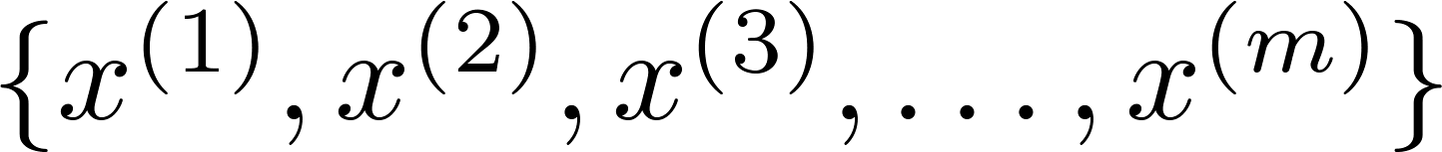
Unsupervised learning
聚类
Training set:
无标签数据

Slide 5


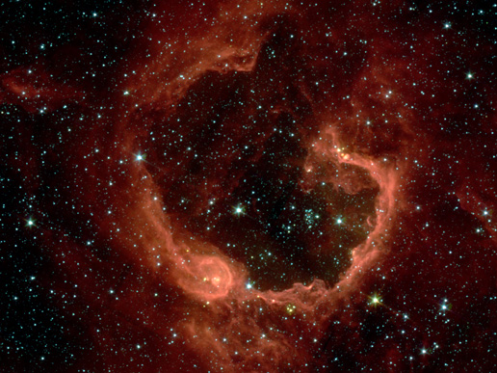
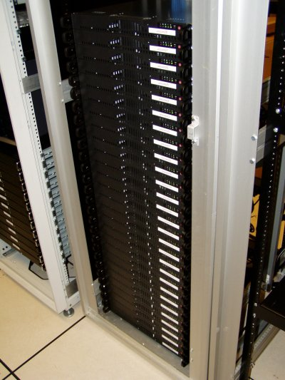

Applications of clustering
Market segmentation
Social network analysis
Image credit: NASA/JPL-Caltech/E. Churchwell (Univ. of Wisconsin, Madison)
Organize computing clusters
Astronomical data analysis
Notes:
Swap: market seg and organize clusters

Slide 6
K-means algorithm
Clustering
Machine Learning

Slide 7
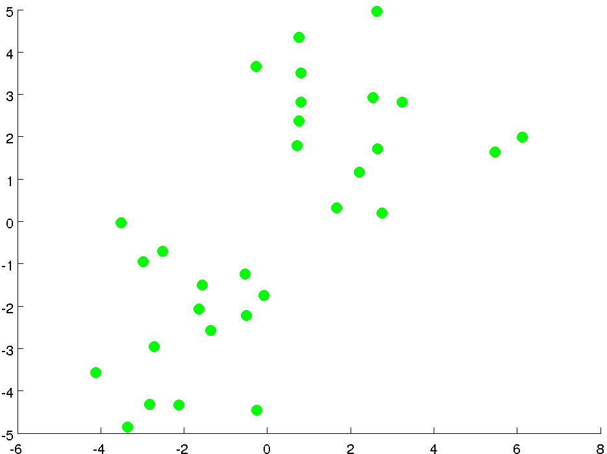
原始无标签数据

Slide 8
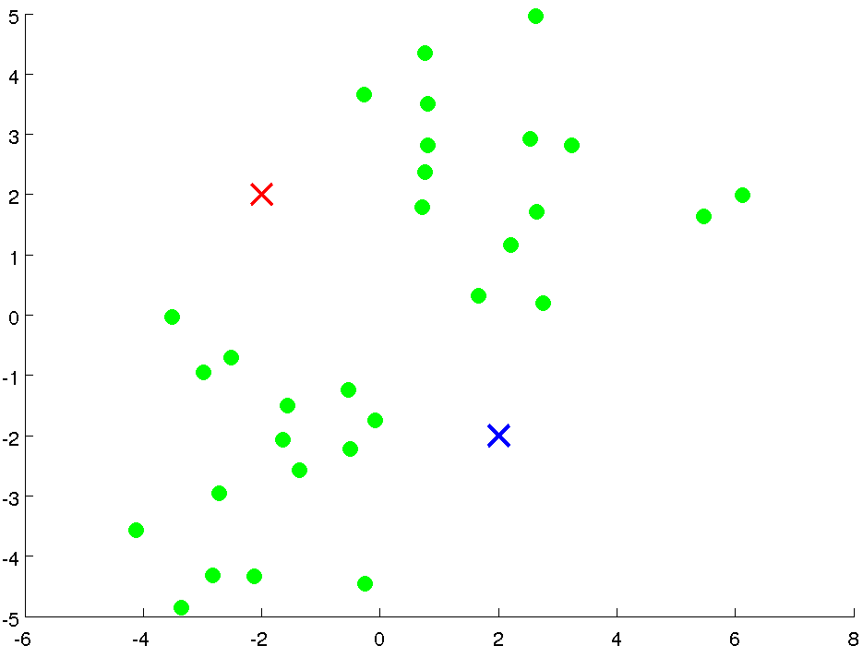
初始化聚类中心

Slide 9
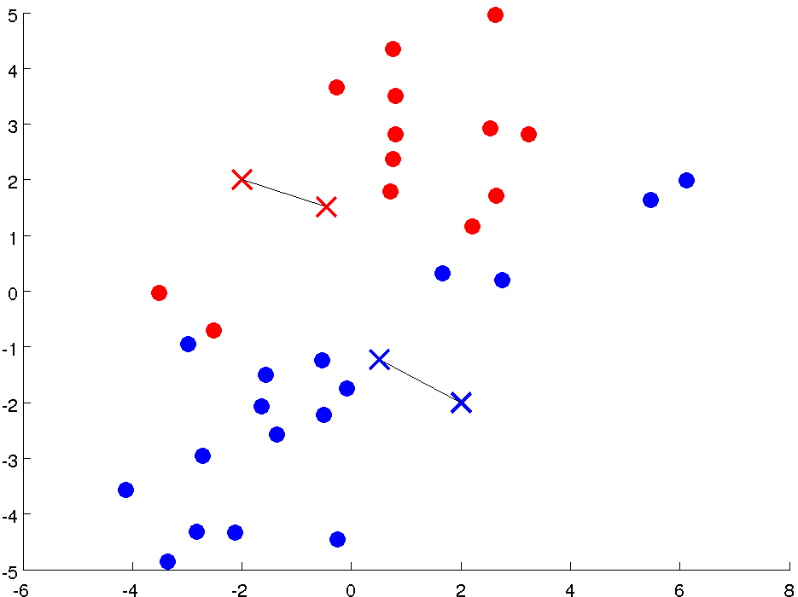
第一次类别标定完成

Slide 10
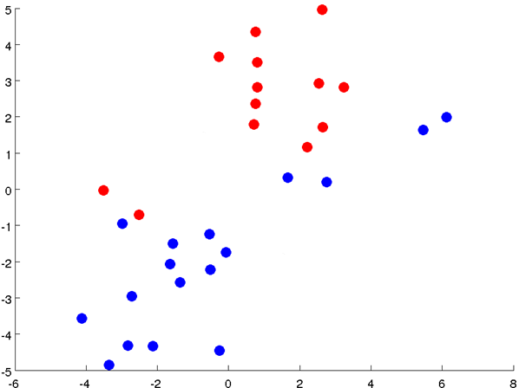
计算新的聚类中心

Slide 11
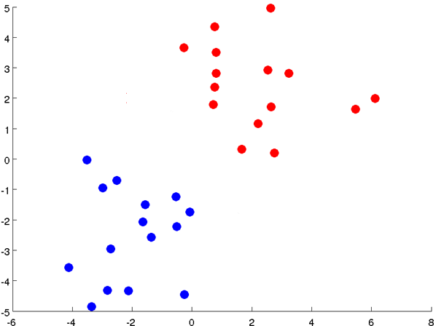
第二次类别标定完成

Slide 12
再次计算新的聚类中心
Notes:
Get rid of the legacy points

Slide 13
第三次类别标定完成
Notes:
Get rid of the legacy points

Slide 14

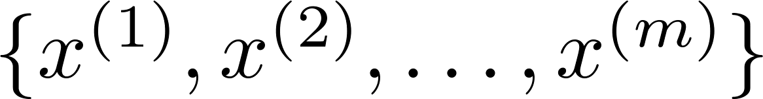
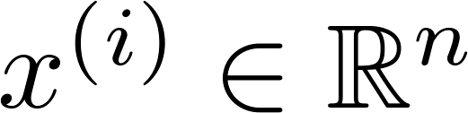

K-means algorithm
Input:
(number of clusters)
Training set
(drop convention)

Slide 15

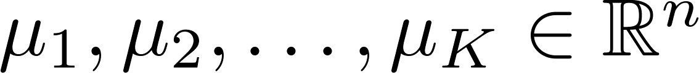





K-means algorithm
Randomly initialize cluster centroids
Repeat {
for = 1 to
:= index (from 1 to ) of cluster centroid
closest to
for = 1 to
:= average (mean) of points assigned to cluster
}
类别标定
移动聚类中心
Notes:
Replace as previous; change spacing to fill page

Slide 16
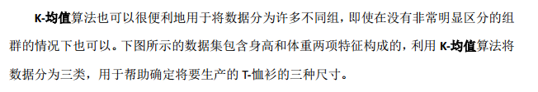
L
M
Weight
S
Height

Slide 17
Optimization objective
Clustering
Machine Learning

Slide 18



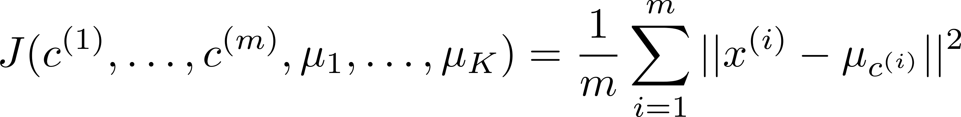
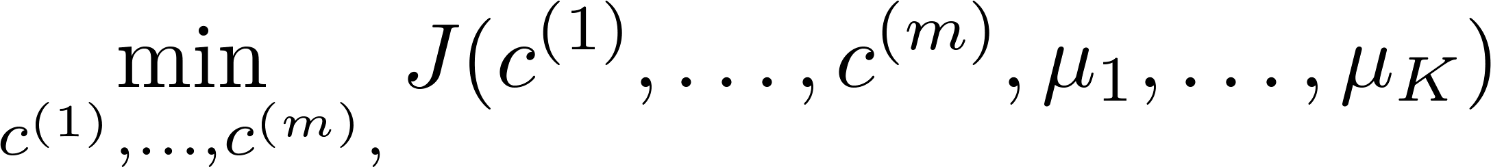

K-means optimization objective
= index of cluster (1,2,…, ) to which example is currently assigned
= cluster centroid ( )
= cluster centroid of cluster to which example has been assigned
Optimization objective:
Notes:
Change numbers to LATEX as well

Slide 19


K-means algorithm
Randomly initialize cluster centroids
Repeat {
for = 1 to
:= index (from 1 to ) of cluster centroid
closest to
for = 1 to
:= average (mean) of points assigned to cluster
}
聚类中心固定，减小 引起的代价
类别标定已完成，减小 引起的代价
Notes:
Replace as previous; change spacing to fill page

Slide 20
Random initialization
Clustering
Machine Learning

Slide 21
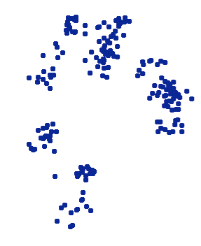
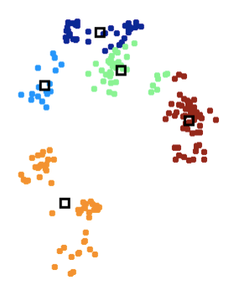
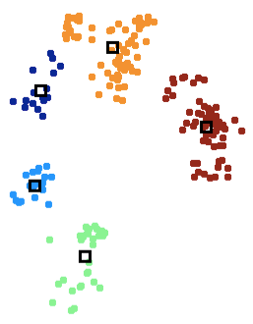
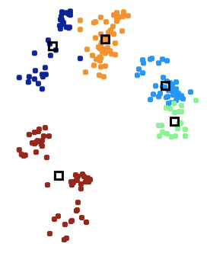
Initialization
Multiple local optima, depending on initialization
Try diﬀerent (randomized) initializations
Can use cost C to decide which we prefer
C = 223.3
C = 212.6
C = 167.0

Slide 22
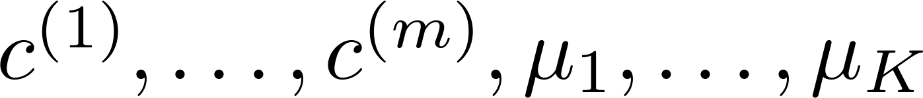
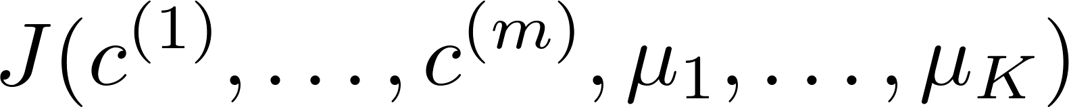
Random initialization
For i = 1 to 100 {
Randomly initialize K-means.
Run K-means. Get .
Compute cost function (distortion)
}
Pick clustering that gave lowest cost

Slide 23
Choosing the number of clusters
Clustering
Machine Learning

Slide 24
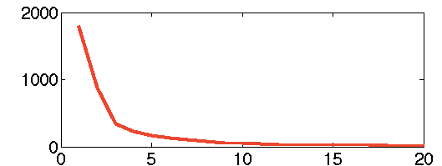
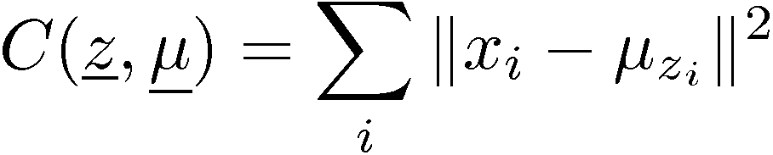
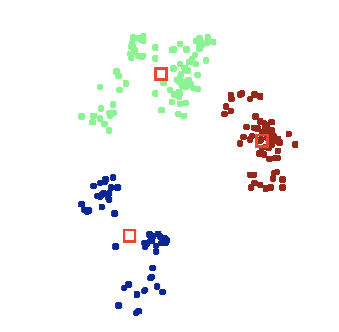
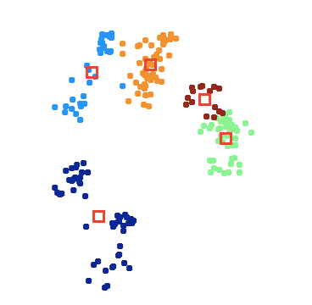
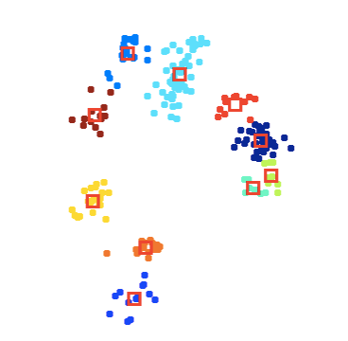
Choosing the number of clusters
With cost function
what is the optimal value of k?
Cost always decreases with k!
A model complexity issue…
K=3
K=5
K=10

Slide 25

Choosing the value of K
Elbow method:
肘部法则
Cost function
Cost function
(no. of clusters)
(no. of clusters)

Slide 26
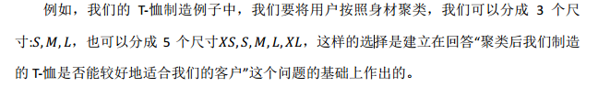
Choosing the value of K
T-shirt sizing
T-shirt sizing
XL
L
L
M
M
S
Weight
Weight
S
XS
Height
Height

Slide 27
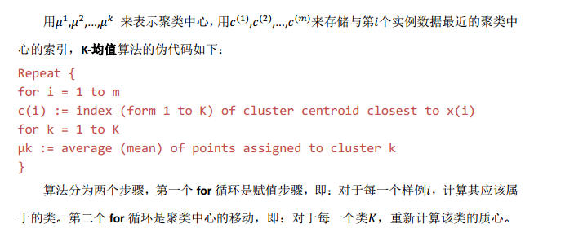
考查要点

Slide 28
Motivation I: Data Compression
Dimensionality Reduction
Machine Learning

Slide 29


Data Compression
Reduce data from
2D to 1D
数据压缩
(inches)
特征冗余
(cm)

Slide 30
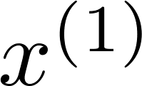
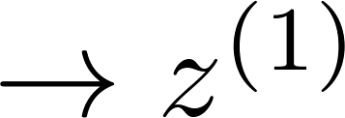

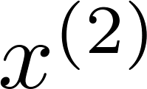
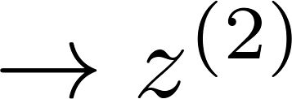


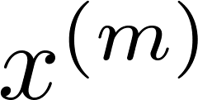
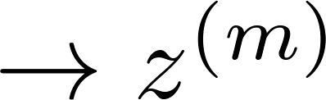


Data Compression
Reduce data from
2D to 1D
(inches)
二维
(cm)
一维
Notes:
Add more unique colors (3-4)

Slide 31
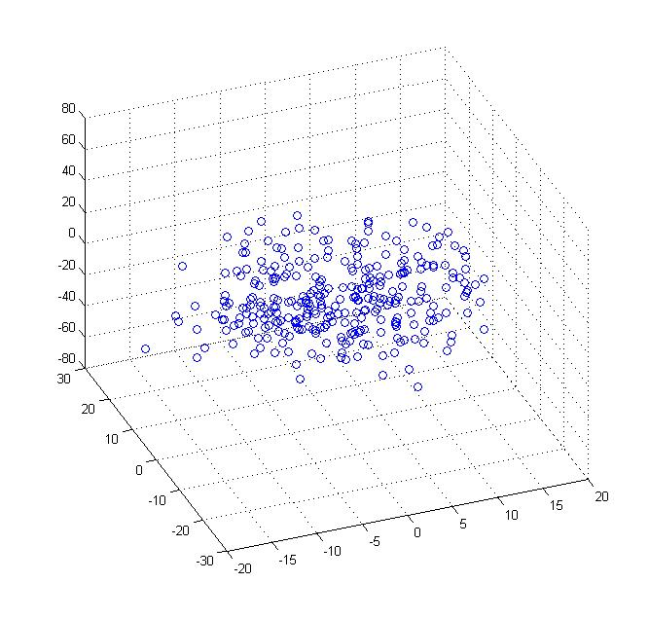
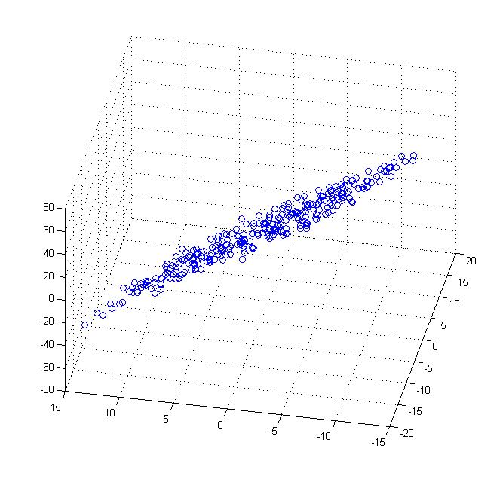
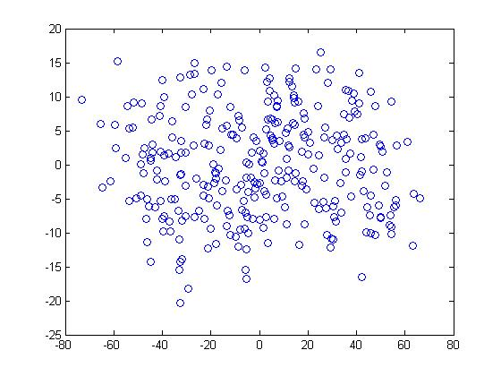


Data Compression
Reduce data from 3D to 2D
Notes:
Pca3d2d in lecture-slides/assets/pca/
Label axes

Slide 32
Motivation II: Data Visualization
Dimensionality Reduction
Machine Learning

Slide 33
数据可视化
Data Visualization
如果要将50维的数据可视化是不可能的
Country | GDP (trillions of US$) | Per capita GDP (thousands of intl. $) | Human Develop-ment Index | Life expectancy | Poverty Index (Gini as percentage) | Mean household income (thousands of US$) | …
Canada | 1.577 | 39.17 | 0.908 | 80.7 | 32.6 | 67.293 | …
China | 5.878 | 7.54 | 0.687 | 73 | 46.9 | 10.22 | …
India | 1.632 | 3.41 | 0.547 | 64.7 | 36.8 | 0.735 | …
Russia | 1.48 | 19.84 | 0.755 | 65.5 | 39.9 | 0.72 | …
Singapore | 0.223 | 56.69 | 0.866 | 80 | 42.5 | 67.1 | …
USA | 14.527 | 46.86 | 0.91 | 78.3 | 40.8 | 84.3 | …
… | … | … | … | … | … | …
[resources from en.wikipedia.org]
Notes:
Add dots

Slide 34
Data Visualization
将数据由50D降为2D
Country
Canada | 1.6 | 1.2
China | 1.7 | 0.3
India | 1.6 | 0.2
Russia | 1.4 | 0.5
Singapore | 0.5 | 1.7
USA | 2 | 1.5
… | … | …
新特征的意义？

Slide 35
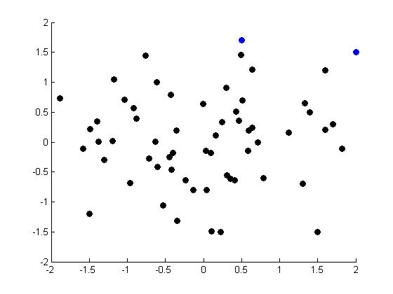
Data Visualization
新加坡
USA
GDP/人
口数
国土面积/GDP
Notes:
Make points look uncorrelated
US, Singapore in blue

Slide 36
Principal Component Analysis problem formulation
Dimensionality Reduction
Machine Learning

Slide 37

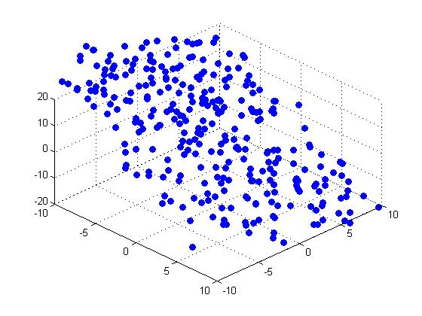

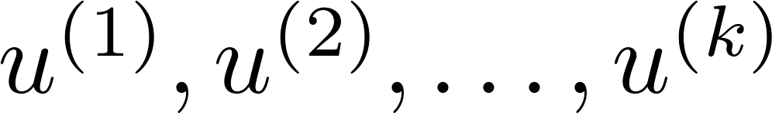
Principal Component Analysis (PCA) problem formulation
Projection error 投射误差
Reduce from n-dimension to k-dimension: Find vectors
onto which to project the data, so as to minimize the projection error.
Notes:
Change numbers to LATEX as well

Slide 38
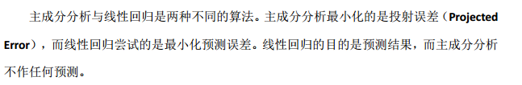
PCA is not linear regression
Notes:
Add animation to block left graph

Slide 39

PCA is not linear regression
Notes:
Add animation to block left graph

Slide 40
Principal Component Analysis algorithm
Dimensionality Reduction
Machine Learning

Slide 41
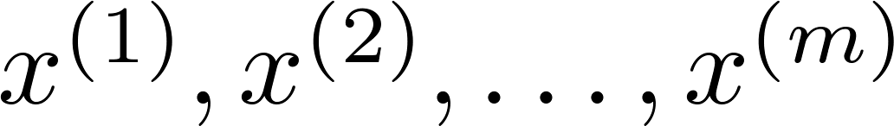
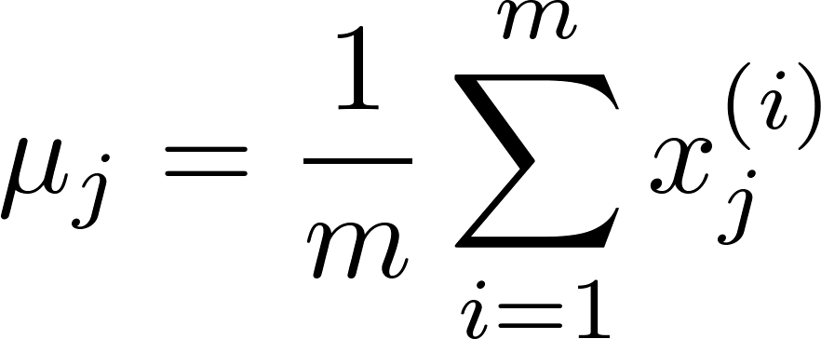
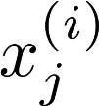




Data preprocessing
Training set:
Preprocessing (feature scaling/mean normalization):
Replace each with .
If different features on different scales (e.g., size of house,
number of bedrooms), scale features to have comparable range of values.
Notes:
Replace as previous; change spacing to fill page

Slide 42


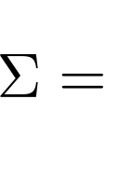
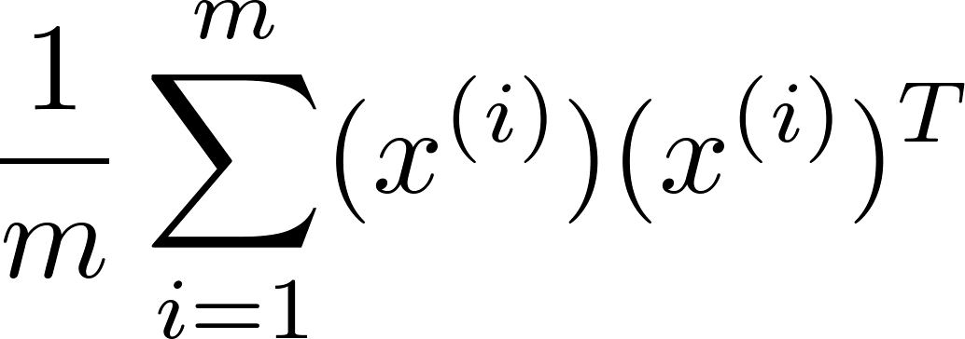

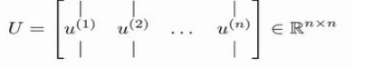
Principal Component Analysis (PCA) algorithm
Reduce data from -dimensions to -dimensions
Compute “covariance matrix”:
Compute “eigenvectors” of matrix :
[U,S,V] = svd(Sigma);
Sigma
Singular Value Decomposition
奇异值分解

Slide 43
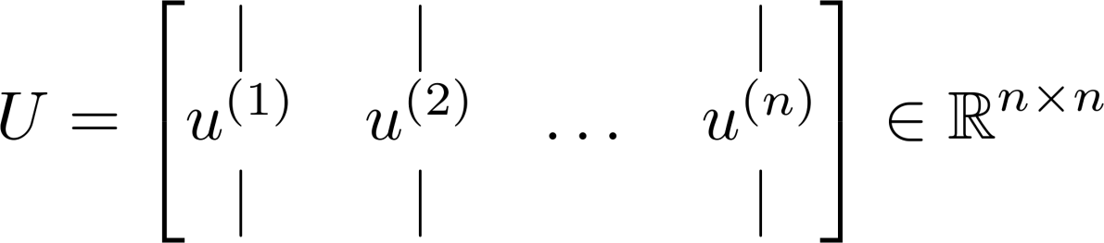
Principal Component Analysis (PCA) algorithm
From , we get:
[U,S,V] = svd(Sigma)
K个主特征向量

Slide 44
Principal Component Analysis (PCA) algorithm summary
After mean normalization (ensure every feature has zero mean) and optionally feature scaling:
Sigma =
[U,S,V] = svd(Sigma);
Ureduce = U(:,1:k);
z = Ureduce’*x;

Slide 45
Choosing the number of principal components
Dimensionality Reduction
Machine Learning

Slide 46


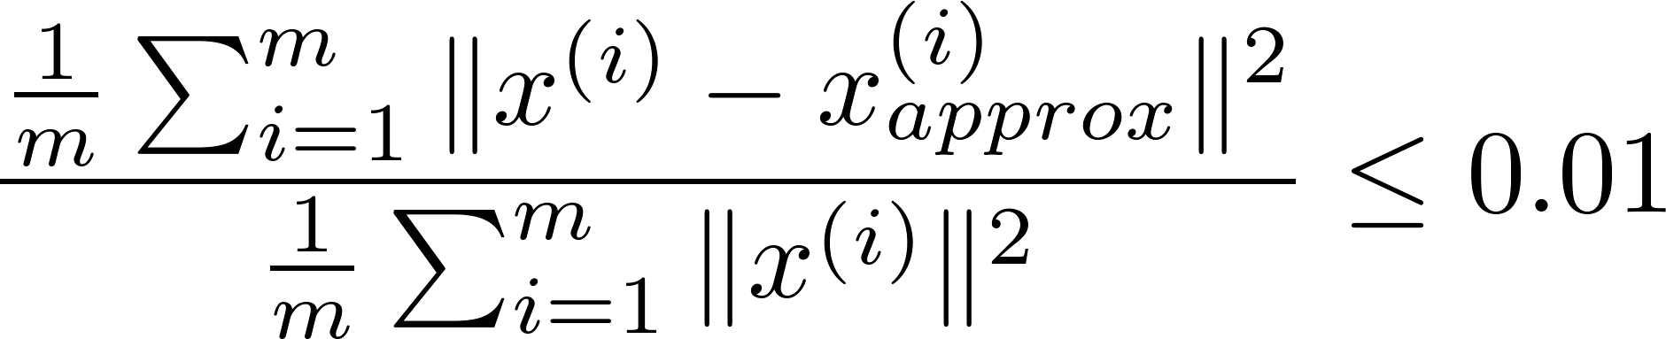
Choosing (number of principal components)
Average squared projection error:
Total variation in the data:
Typically, choose to be smallest value so that
“99% of variance is retained”
(1%)

Slide 47

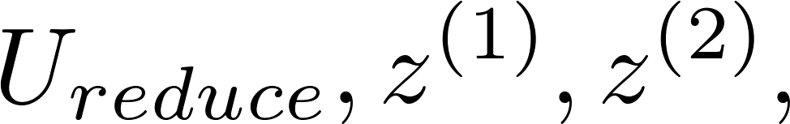

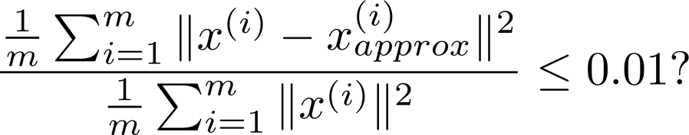

Choosing (number of principal components)
Algorithm:
Try PCA with
Compute
Check if
[U,S,V] = svd(Sigma)

Slide 48
Reconstruction from compressed representation
Dimensionality Reduction
Machine Learning

Slide 49

Reconstruction from compressed representation
Notes:
Make points have 0 mean on x1 and x2

Slide 50
Advice for applying PCA
Dimensionality Reduction
Machine Learning

Slide 51
Application of PCA
Compression
Reduce memory/disk needed to store data
Speed up learning algorithm
Visualization
数据压缩
数据可视化

Slide 52

Supervised learning speedup

Slide 53




Bad use of PCA: To prevent overfitting
常见错误一：将其用于减少过拟合
Use instead of to reduce the number of features to
Thus, fewer features, less likely to overfit.
PCA只是近似丢弃掉一些特征，它并不考虑任何与结果变量有关的信息，
因此可能会丢失非常重要的特征。此时使用正则化较好。
This might work OK, but isn’t a good way to address overfitting. Use regularization instead.

Slide 54






PCA is sometimes used where it shouldn’t be
常见错误二：默认地将PCA作为学习过程中的一部分
Design of ML system:
Get training set
Run PCA to reduce in dimension to get
Train logistic regression on
Test on test set: Map to . Run on
How about doing the whole thing without using PCA?
最好还是从所有原始特征开始，只在有必要的时候（算法运行太慢或者占用太多
内存）才考虑采用主要成分分析

Slide 55





考查要点

